Slide 1
Micro CREDIT DEFAULTER
PRESENTED by
Anum Yusuf

Slide 2

Micro Credit Defaulter Model

Slide 3
Agenda:
Overview
Problem Statement
Problem Understanding
What is Micro Credit and its Importance?
Exploratory Data Analysis
Visualization
Data Cleaning
Balancing Data
Model Building
Cross Validation
Hyper Parameter Tuning
ROC-AUC Curve
Saving the model and making the prediction
Conclusion

Slide 4
Overview:
In this Micro Credit Defaulter Project we will be look on
How to analyse the data?
What are the EDA Steps in Data cleaning?
Visualization of all features and compare with the Target variable.
Model Building and make the predictions for Micro Credit
Finalizing the model to make our final prediction.
Saving the Model for future use.

Slide 5
Problem Statement:
A Microfinance Institution (MFI) is an organization that offers financial services to low income populations. MFS becomes very useful when targeting especially the unbanked poor families living in remote areas with not much sources of income. The Microfinance services (MFS) provided by MFI are Group Loans, Agricultural Loans, Individual Business Loans and so on.
Many microfinance institutions (MFI), experts and donors are supporting the idea of using mobile financial services (MFS) which they feel are more convenient and efficient, and cost saving, than the traditional high-touch model used since long for the purpose of delivering microfinance services. Though, the MFI industry is primarily focusing on low income families and are very useful in such areas, the implementation of MFS has been uneven with both significant challenges and successes.
Today, microfinance is widely accepted as a poverty-reduction tool, representing $70 billion in outstanding loans and a global outreach of 200 million clients.
We are working with one such client that is in Telecom Industry. They are a fixed wireless telecommunications network provider. They have launched various products and have developed its business and organization based on the budget operator model, offering better products at Lower Prices to all value conscious customers through a strategy of disruptive innovation that focuses on the subscriber.
They understand the importance of communication and how it affects a person’s life, thus, focusing on providing their services and products to low income families and poor customers that can help them in the need of hour.
They are collaborating with an MFI to provide micro-credit on mobile balances to be paid back in 5 days. The Consumer is believed to be defaulter if he deviates from the path of paying back the loaned amount within the time duration of 5 days. For the loan amount of 5 (in Indonesian Rupiah), payback amount should be 6 (in Indonesian Rupiah), while, for the loan amount of 10 (in Indonesian Rupiah), the payback amount should be 12 (in Indonesian Rupiah).
The sample data is provided to us from our client database. It is hereby given to you for this exercise. In order to improve the selection of customers for the credit, the client wants some predictions that could help them in further investment and improvement in selection of customers.

Slide 6
Problem Understanding
Telecom Industry understand the importance of communication and how it affects a person’s life, thus, focusing on providing their services and products to low income families and poor customers that can help them in the need of hour.
They are collaborating with an MFI to provide micro-credit on mobile balances to be paid back in 5 days. The Consumer is believed to be defaulter if he deviates from the path of paying back the loaned amount within the time duration of 5 days. For the loan amount of 5 (in Indonesian Rupiah), payback amount should be 6 (in Indonesian Rupiah), while, for the loan amount of 10 (in Indonesian Rupiah), the payback amount should be 12 (in Indonesian Rupiah).
The sample data is provided to us from our client database. It is hereby given to you for this exercise. In order to improve the selection of customers for the credit, the client wants some predictions that could help them in further investment and improvement in selection of customers.

Slide 7

What is micro credit?
Microcredit is small loans granted to low income individuals that are excluded from the traditional banking system. It is part of the larger microfinance industry, which provides not only credit, but also savings, insurance, and other basic financial services to the poor.

Slide 8
Importance of micro credit
Microfinance is important because it provides resources and access to capital to the financially underserved, such as those who are unable to get checking accounts, lines of credit, or loans from traditional banks.
Without microfinance, these groups may have to resort to using risky loans or payday advances with extremely high interest rates or even borrow money from family and friends. Microfinance helps them invest in their businesses and, as a result, invest in themselves.
While microfinance can certainly benefit those stateside, it can also serve as an important resource for those in the developing world.

Slide 9
Exploratory DATA ANALYSIS
First I have imported all the necessary Library and imported the data.
Checked the count of data, its uniqueness value, columns names, Information of data, statistical description of data.
Checked the null value, there is no null value present in the data.
In some columns there are more than 90% zero values are present. So, I have dropped the column from the data set.
Extracted the month, day and year from pdate and dropped the pdate column after extraction.
Checked the Outliers in data, most of the columns Outliers are present. We have removed the Outliers using the zscore method. In the Outliers removal process we lost the 7.4% data.
Checked the skewness in data, Removed the skewness which is highly skewed.

Slide 10
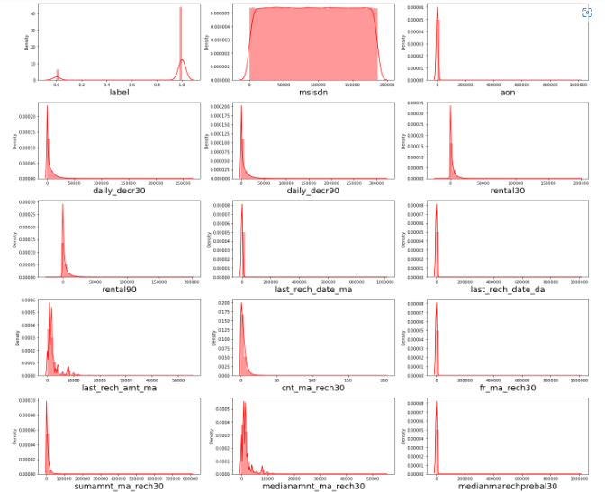
Data Visualization

Slide 11
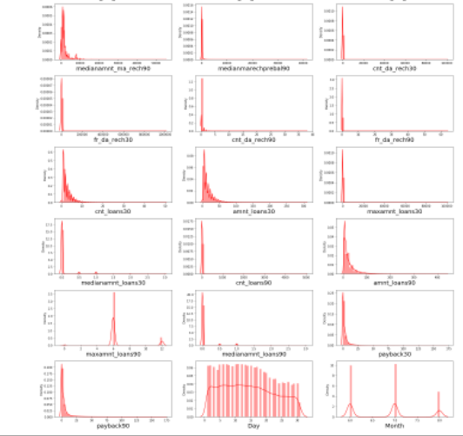
In the distribution plot of all features, we clearly see that skewness is present in almost all the columns. We have to remove the skewness using the appropriate method.

Slide 12
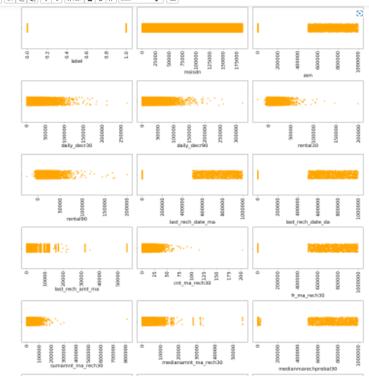

Slide 13
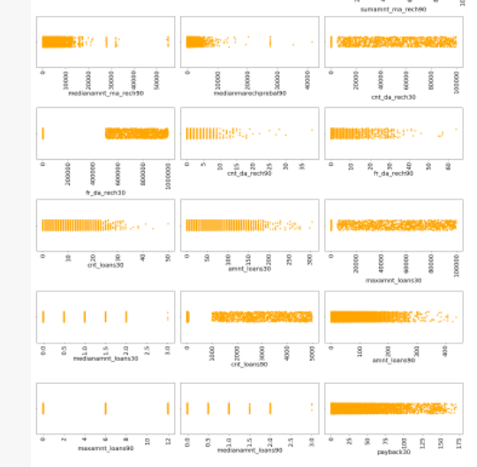

Slide 14
OBSERVATION
1.Customers with high value of Age on cellular network in days(aon) are maximum defaulters(who have not paid there loan amount-0).
2.Customers with high value of Daily amount spent from main account, averaged over last 30 days (in Indonesian Rupiah)(daily_decr30) are maximum Non-defaulters(who have paid there loan amount-1).
3.Customers with high value of Daily amount spent from main account, averaged over last 90 days (in Indonesian Rupiah)(daily_decr90) are maximum Non-defaulters(who have paid there loan amount-1).
4.Customers with high value of Average main account balance over last 30 days(rental30) are maximum Non-defaulters(who have paid there loan amount-1).
5.Customers with high value of Average main account balance over last 90 days(rental90) are maximum Non-defaulters(who have paid there loan amount-1).
6.Customers with high Number of days till last recharge of main account(last_rech_date_ma) are maximum Non-defaulters(who have paid there loan amount-1).
7.Customers with high value of Amount of last recharge of main account (in Indonesian Rupiah)(last_rech_amt_ma) are maximum Non-defaulter.

Slide 15
8.Customers with high value of Number of times main account got recharged in last 30 days(cnt_ma_rech30) are maximum Non-defaulters(who have paid there loan amount-1).
9.Customers with high value of Frequency of main account recharged in last 30 days(fr_ma_rech30) are maximum Non-defaulters(who have paid there loan amount-1) and also the count is high for defaulters comparatively Non-defaulters are more in number.
10.Customers with high value of Total amount of recharge in main account over last 30 days (in Indonesian Rupiah)(sumamnt_ma_rech30) are maximum Non-defaulters(who have paid there loan amount-1).
11.Customers with high value of Median of amount of recharges done in main account over last 30 days at user level (in Indonesian Rupiah)(medianamnt_ma_rech30) are maximum Non-defaulters(who have paid there loan amount-1).
12.Customers with high value of Median of main account balance just before recharge in last 30 days at user level (in Indonesian Rupiah)(medianmarechprebal30) are maximum defaulters(who have not paid there loan amount-0).
13.Customers with high value of Number of times main account got recharged in last 90 days(cnt_ma_rech90) are maximum Non-defaulters(who have paid there loan amount-1).

Slide 16
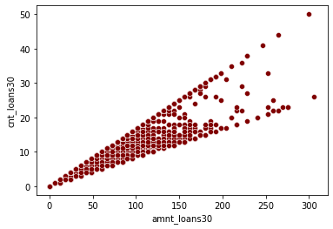
In the Scatterplot, we see that amnt_loans 30 is drastically increasing, majority lies in the range of 100 to 200.

Slide 17
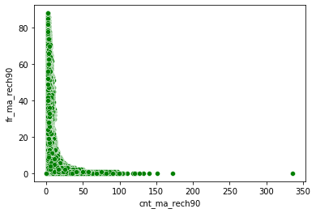
In fr_ma_reach90 it goes to the maximum 80 range. In cnt_ma_rech90 it lies from 0 to 150.

Slide 18
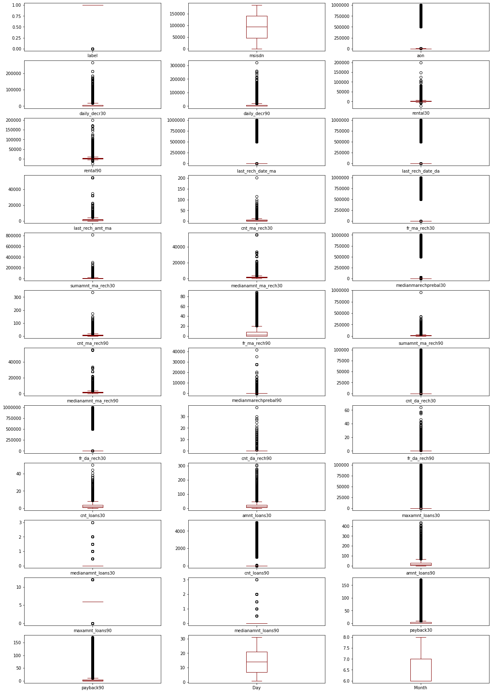

Slide 19
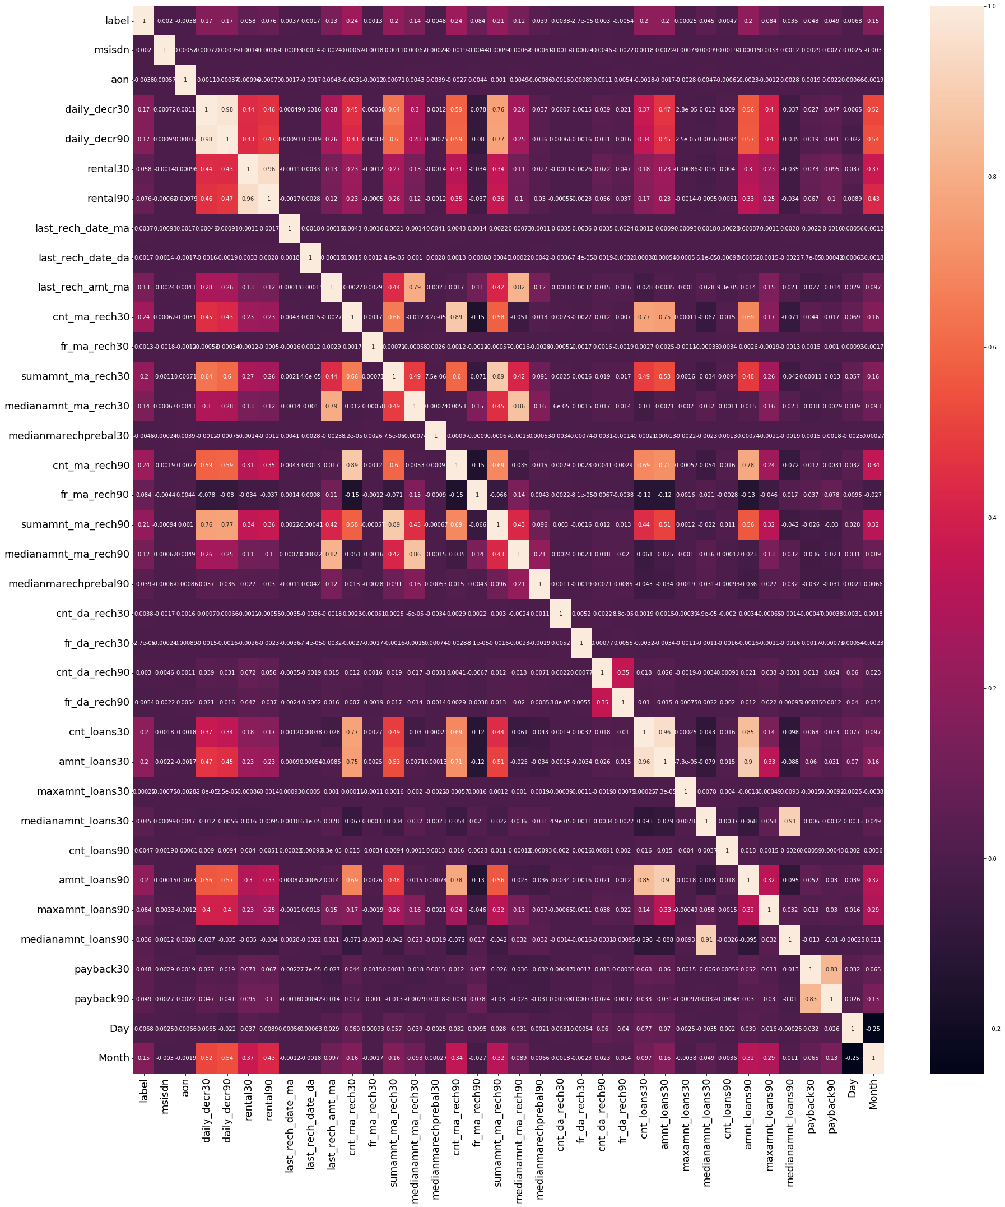
CORRELATION

Slide 20
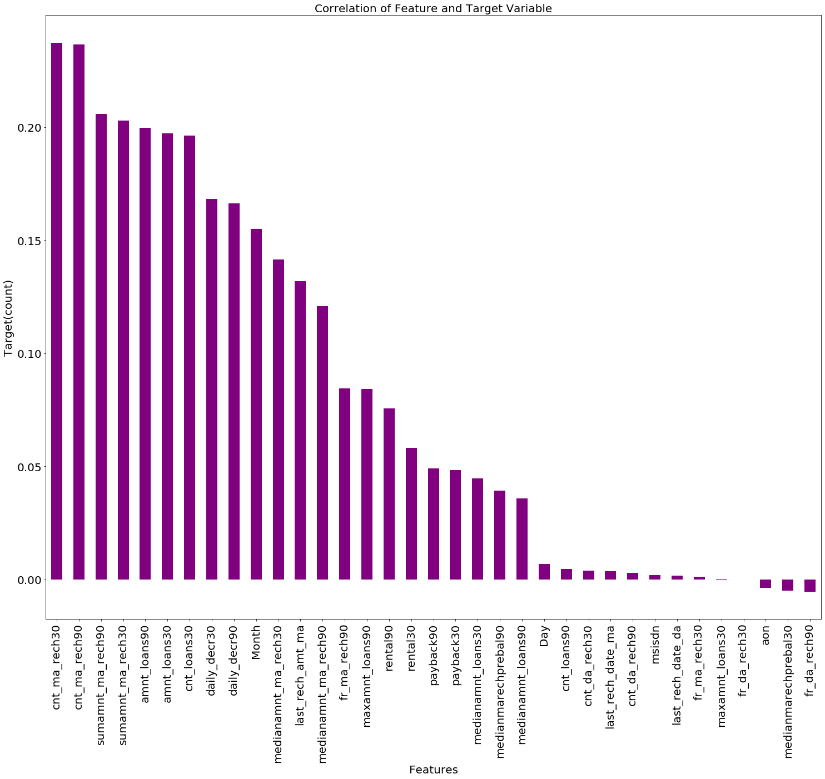
CORRELATION OF FEATURES AND TARGET

Slide 21
Data Cleaning
In our data set there is no null value present.
As we see in the distribution plot, there are skewness present. We need to remove skewness using the Power Transformer method
In the box plot there are outliers are present. We need to remove the outliers using the zscore method. While removing the outliers we need to be careful that we should not lost the data more than 8%. Our data is sensitive.
There are categorical data present, convert the data from categorical to numerical data.
We have extracted the day, month from pdate column
Removed the unnecessary column that have more than 90% zero values.
We have checked the correlation of data and removed the data which is highly correlated.
Balancing the data using the SMOTE
Scaled the data for training and testing data.

Slide 22
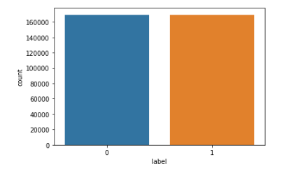
Data Balancing
Our target label was imbalance, we have balance the data using the over sampling technique using SMOTE

Slide 23
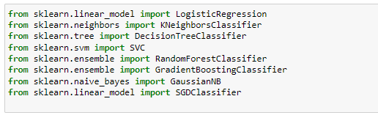
Model Building
Our target variable is Label, it is 0 and 1. So, our problem is Classification problem. I have used various model and check the accuracy score, confusion matrix and the classification report.
Compare the accuracy score with other model to check which model gives a best accuracy score. We have done the cross validation score, hyper tuning of the final model.
Plot the ROC-AUC Curve.
Model used in the project is
Logistic Regression
Decision Tree Classifier
Random Forest Classifier
Gradient Boosting Classifier
SGD Classifier
KNeighbors Classifier.

Slide 24
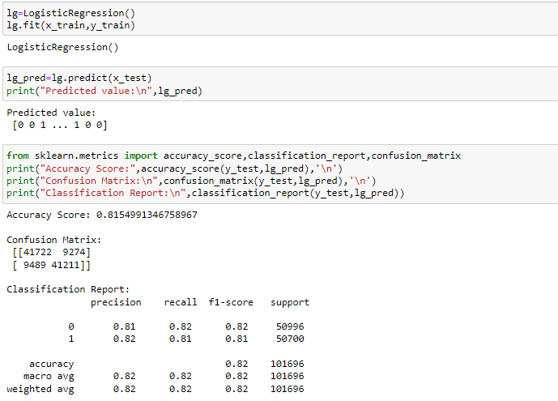
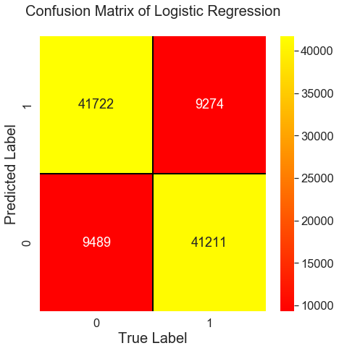
Logistic Regression
In the Logistic Regression, we got 81% Accuracy.

Slide 25
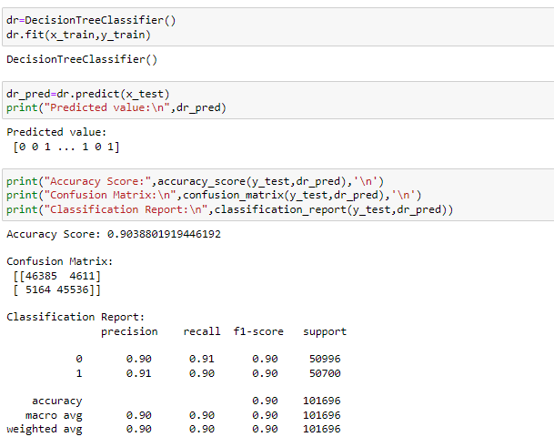
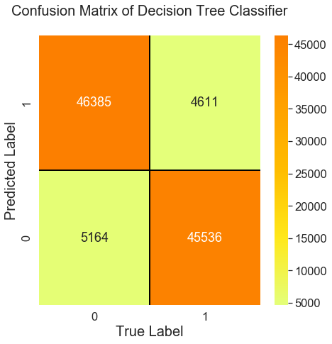
Decision Tree Classifier
In the Decision Tree Classifier, we got 90% Accuracy.

Slide 26
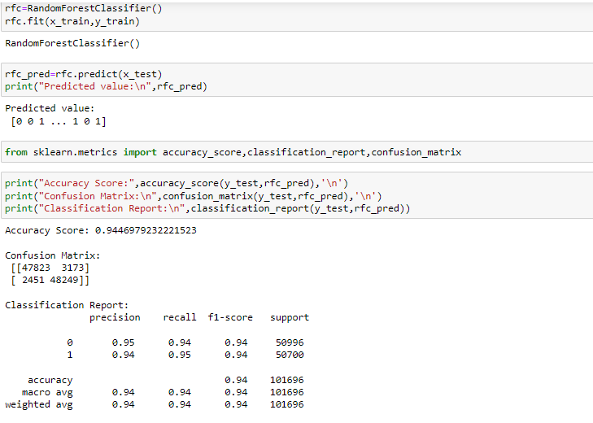
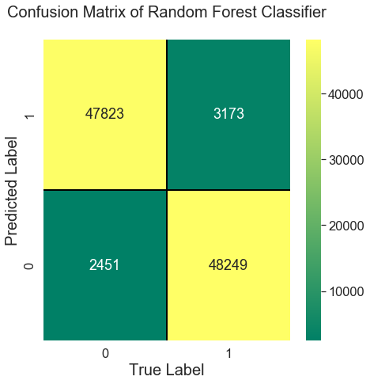
Random Forest Classifier
In the Random Forest Classifier, we got 94% Accuracy.

Slide 27
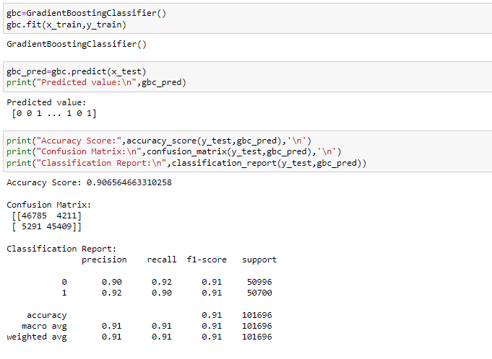
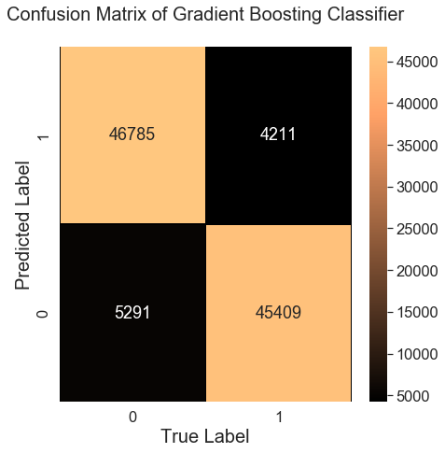
Gradient Boosting Classifier
In the Gradient Boosting Classifier, we got 90% Accuracy.

Slide 28
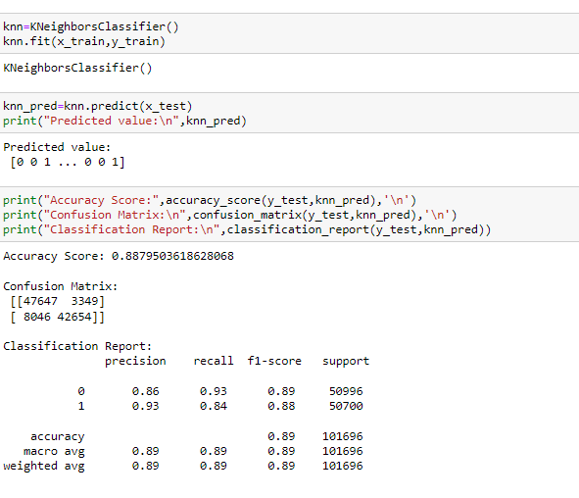
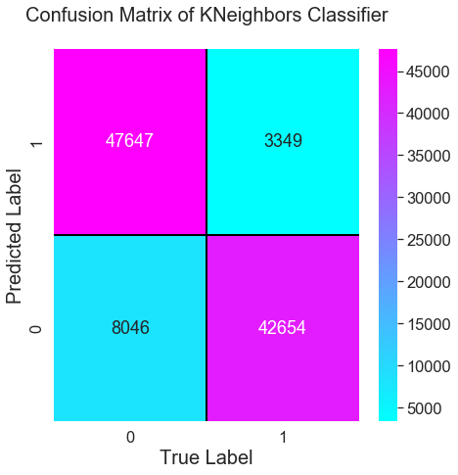
KNeighbors Classifier
In the KNeighbors Classifier, we got 88% Accuracy.

Slide 29
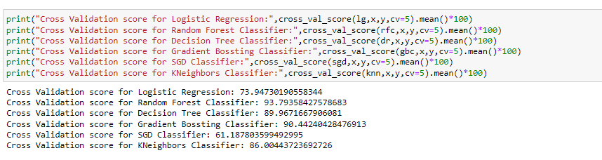
CROSS VALIDATION SCORE
On Analysis of various model cross validation score, we found that Random Forest Classifier gives a good Validation Score 94%. So, we will consider the Random Forest Classifier as our final model.

Slide 30
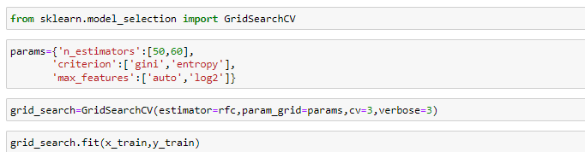
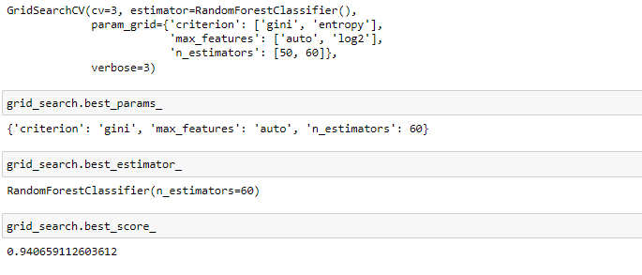
Hyper parameter tuning
After tuning the parameter for Random Forest Classifier, we got best score 94%. Which is a very good score.

Slide 31
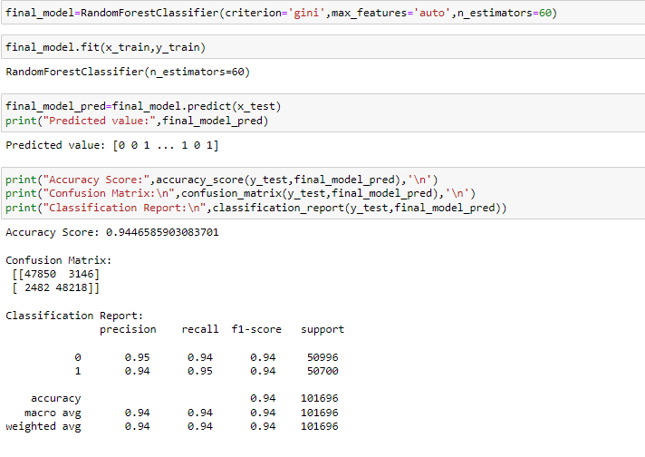
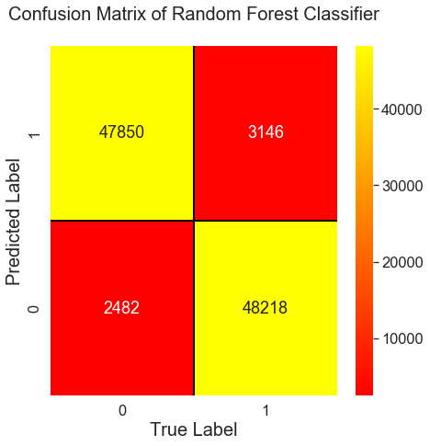
Final Model
Random Forest Classifier is our final, after tuning the parameter, we train and test the model and we got the accuracy score is 94%.

Slide 32
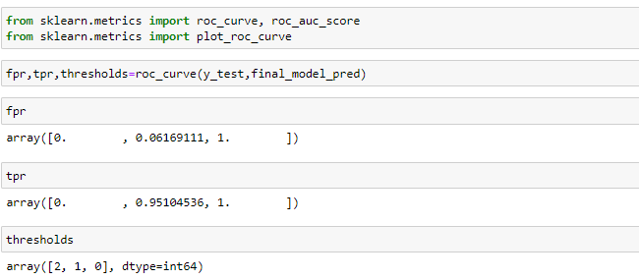
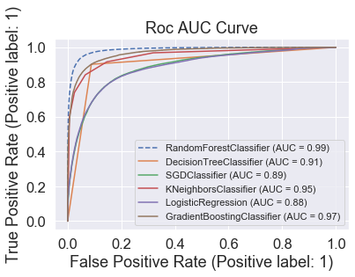
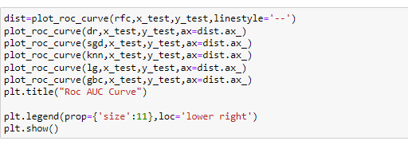
ROC-AUC Curve
In ROC-AUC Curve, we got the best AUC Score for Random Forest is 99%

Slide 33
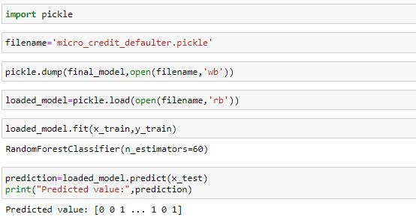
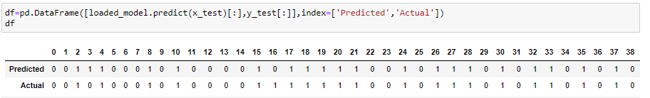
Saving the model
I have saved my final model in Pickle. Predicted the value for Micro Credit Defaulter. The Value almost looks Similar with the actual value.

Slide 34
CONCLUSION
In this project we have used the machine learning model to make prediction for Micro Credit Defaulter. We have done the step by steps analysis. We have check the correlation of data, its null values.
With the help of visualization, it provides a insight of all features and helps us to understand the data through Visualization.
Data Cleaning is the most crucial steps in this project, we have removed the outliers and skewness present in the data.
We have converted the categorical data to numerical data.
We have dropped the unnecessary columns which have more than 90% zero values.
I have used 6 Machine Learning Algorithm and checked their accuracy score, confusion matrix and classification report of each algorithm.

Slide 35
We have done the cross validation score for each model and checked the score, compared with model and choose the model which is giving the high score. In our project Random Forest Classifier gives a good score.
We have done the Hyper parameter tuning for our final model. Random Forest Classifier is our final model and it gives the score 94% after tuning the parameter.
Then we have saved our final model. We observed that our predicted value and actual value almost look similar.
With this prediction, it helps the Finance Company to make the prediction who will pay the credit loan within 5 days.

Slide 36
Thank You

